Slide 1

Trade Finance Platform
A robust full-stack application streamlining trade finance document management with enterprise-grade security and role-based access control

Slide 2


Core Platform Features
JWT Authentication
Role-Based Access
Secure login, registration, and token-based session management
Bank, Corporate, Auditor, and Admin permission levels
Document Hub
Security First
Upload and manage six critical trade finance document types
bcrypt password hashing with access and refresh tokens

Slide 3

Technology Stack
Backend Architecture
Frontend Stack
React - Component-based UI framework
FastAPI - High-performance async framework
Vite - Lightning-fast build tool and dev server
PostgreSQL - Relational database with SQLAlchemy ORM
Tailwind CSS - Utility-first styling framework
JWT - Token authentication via python-jose
Axios - Promise-based HTTP client
bcrypt - Industry-standard password encryption
ESLint - Code quality and consistency
Pydantic - Data validation and serialization

Slide 4
Document Types Supported
Letter of Credit
Commercial Invoice
Bank guarantees for international trade transactions
Detailed billing documents for goods and services
Bill of Lading
Purchase Order
Transport receipts and shipment evidence
Buyer commitments for product procurement
Certificate of Origin
Insurance Certificate
Product source verification for customs
Cargo coverage and risk protection documents

Slide 5
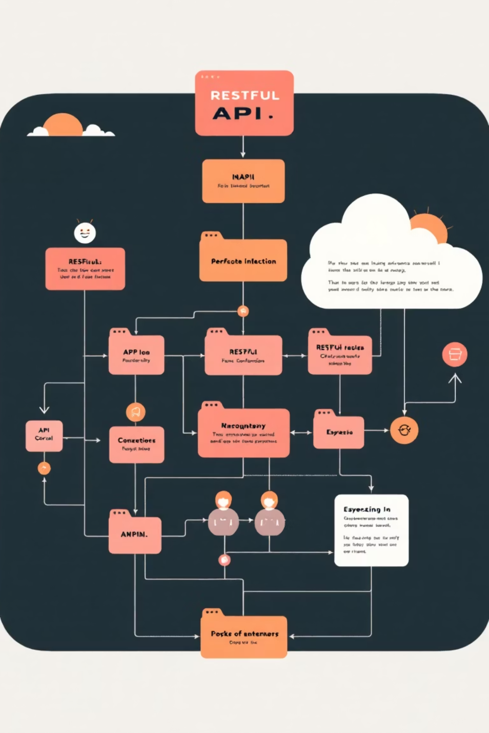
API Architecture
Authentication Endpoints
/auth/register - New user registration
/auth/login - User authentication
/auth/refresh - Token renewal
Document Operations
GET /documents/ - Retrieve all documents
POST /documents/ - Upload new document
GET /documents/ - Fetch specific document
User Management
GET /users/ - List all users (Admin only)
GET /users/me - User details

Slide 6

Getting Started
Clone & Install
Set up virtual environment, install dependencies via pip and npm
Configure Environment
Create .env files with database URL, secret keys, and API endpoints
Database Setup
Run PostgreSQL migrations and initialize schema with Alembic
Launch Services
Start FastAPI backend on :8000 and React frontend on :5173
Ready to build? Push to groupA branch and create pull requests for review

